Slide 1
Font: Calibri, Size: 28, Style: Bold
The Management, Faculty, Staff and Students ​
of ​ Institute of Aeronautical Engineering
​
Extend a Hearty Welcome ​
to​
Honorable Members of ​NBA Expert Committee​
​

Slide 2
Font: Calibri, Size: 32, Style: Bold
Presentation for extension of
(Small Caps)National Board of Accreditation (NBA)
B.Tech: Aero, CSE, IT, ECE, EEE, ME and CE
Under Tier – II Document
by
Dr. L V Narasimha Prasad
Principal
06 February, 2019

Slide 3
Outline (Font: Calibri, Size: 28, Style: Bold)
History and Growth Font: Calibri, Size: 20, Style: Bold
Vision, Mission, Affiliations and Accreditation
Administrative Structure
Human Resources and Achievements
Future Planning and Strategies for Implementation
Research & Innovation
Financial and Physical Resources
Infrastructure
Placement and Student Activities / Higher Studies / Achievements
Implementation of Outcome Based Education
Overall Improvement Since last Accreditation

Slide 4
History and Growth (Title Slide: Calibri, 28, Bold)
IARE - History and Growth

Slide 5
History and Growth (Running Slide: Calibri, 28, Bold)
Maruthi Educational Society, Hyderabad bearing Registration number 389/94 was founded in January 1994. (Font: Calibri, Size: 24, Style: Regular)
The Society was registered under the Andhra Pradesh (Telangana Area) Public Societies Registration Act, 1350 Fasli (Act 1 of 1350 F).
Mission of Society: Education for Liberation
Since inception, the institute earned wide reputation of being one of the premier chain of educational institutions in the State.

Slide 6
History and Growth (Running Slide: Calibri, 28, Bold)
Aero Design Challenge - East
12 Students and 3 faculty participated at Texas, USA on 8 – 11 March 2019. (Font: Calibri, Size: 24, Style: Regular)
Design is Appreciated
A grant of Rs. 10 Lakhs received from AICTE towards travel and accommodation
Total cost incurred: 55 lakhs

Slide 7
B.Tech Programs (Table Slide: Calibri, 28, Bold)
Name of the Course | Year of Estd.
Aeronautical Engineering (120) (Font: Calibri, Size: 22, Style: Regular) | 2000
Computer Science and Engineering (240) | 2001
Information Technology (120) | 2001
Electronics and Communication Engineering (240) | 2004
Electrical and Electronics Engineering (120) | 2004
Mechanical Engineering (120) | 2004
Civil Engineering (120) | 2008

Slide 8
B.Tech Approved Intake : 2018 – 19 (3 Color Scheme)
Name of the Course | I Year |  | II Year Under Lateral Entry
 | Intake | Admitted | Approved | Admitted
Aeronautical Engineering | 120 | 118 | 24 | 22
Computer Science and Engineering | 240 | 240 | 48 | 29
Information Technology | 120 | 120 | 24 | 01
Electronics and Communication Engineering | 240 | 240 | 48 | 48
Electrical and Electronics Engineering | 120 | 107 | 24 | 24
Mechanical Engineering | 120 | 116 | 24 | 24
Civil Engineering | 120 | 119 | 24 | 24
Total | 1080 | 1060 | 216 | 172

Slide 9
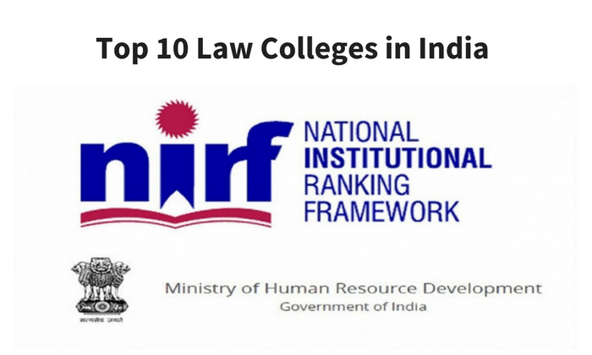
IARE -Top Ratings (Images Slide)
15
151-200
38
2017
61
08
04
04
09
32
15
Notes:
South India Placed @ 44
South India Placed @ 15
4/5 rating
In South India Placed @ 27
India Rank-band: 51-65

Slide 10
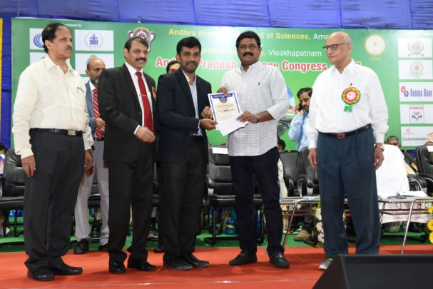
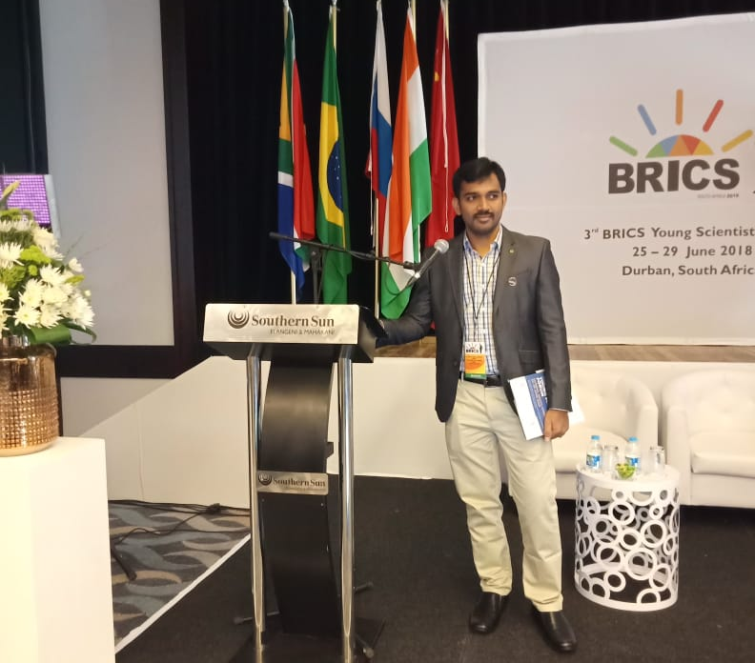
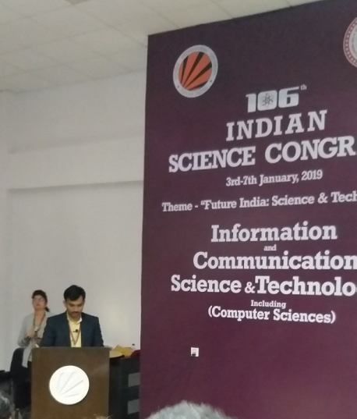
Achievements of Faculty (3 Column Template)
Young Scientist 2017
Dr. Gandikota Ramu has awarded as Young Scientist Award on 7 November, 2017 from Andhra Pradesh Academy of Sciences, Andhra Pradesh. (Font: Calibri, Size: 18, Style: Regular)
BRICS Young Scientist Conclave
Dr. Gandikota Ramu has been invited by DST, New Delhi to deliver a talk on ICT through International Multilateral and Regional Cooperation to 3rd BRICS Young Scientist Conclave held at Durban, South Africa from 25-29 June, 2018.
106th Indian Science Congress – Young Scientist Awardee
Dr. Gandikota Ramu has been short listed as one among the three members to deliver a talk on CS & IT held at LPU, Jalandhar, Punjab during 3 – 7 Jan, 2018

Slide 11
Academic Partnerships (2 Column Template)
Academic MoUs
King Mongkut’s Institute of Technology, Bangkok, Thailand.
Southern University and A&M College, Louisiana, U.S.A.
Nakhon Pathom Rajabhat University,, Bangkok, Thailand.
Vietnam National University, Ho Chi Minh City, Vietnam.
Military College of Electronics and Mechanical Engineering, Secunderabad
Understandings of Collaboration
Development of collaborative research.
Organization of seminars, workshops and other meetings on specific topics.
Exchange of students
Exchange of research scholars.
Exchange of faculty members
MoUs about to sign:

Slide 12
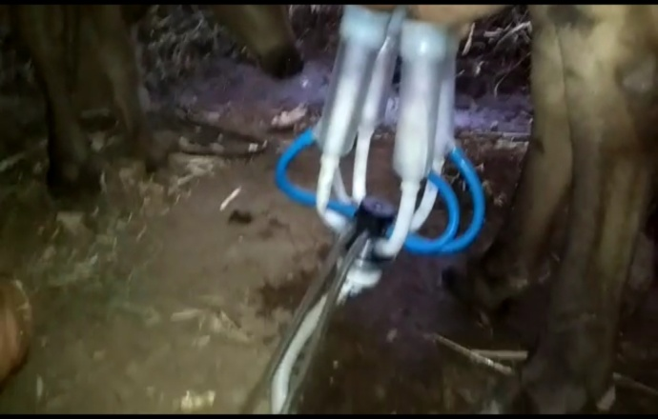
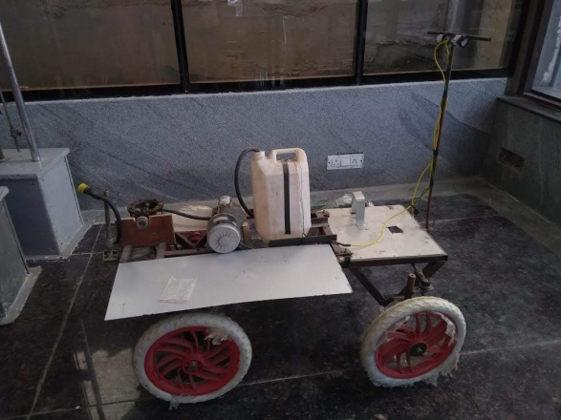
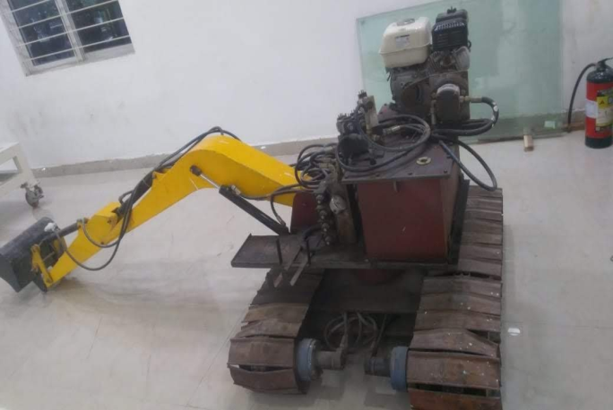
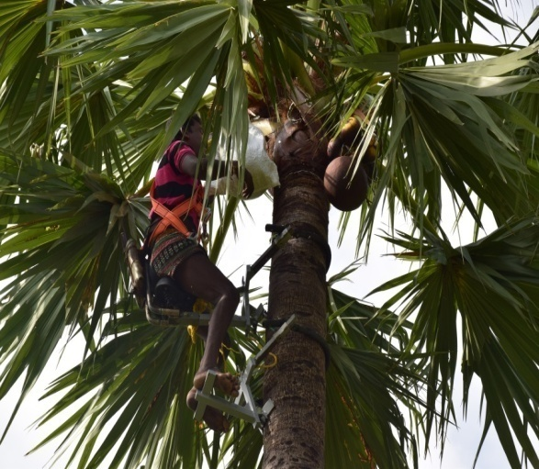
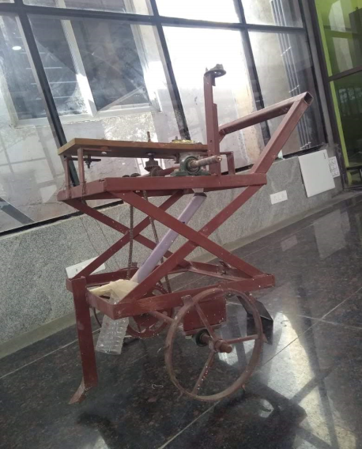
Innovative Projects (Images Slide with text)
Milk Extraction Machine (Font: Calibri, Size: 16, Style: Regular)
Pesticide Spraying Machine
Solar Powered Tricycle
Remote Controlled Mechanical Excavator
ROHAKA
Rice Transplanting Machine

Slide 13
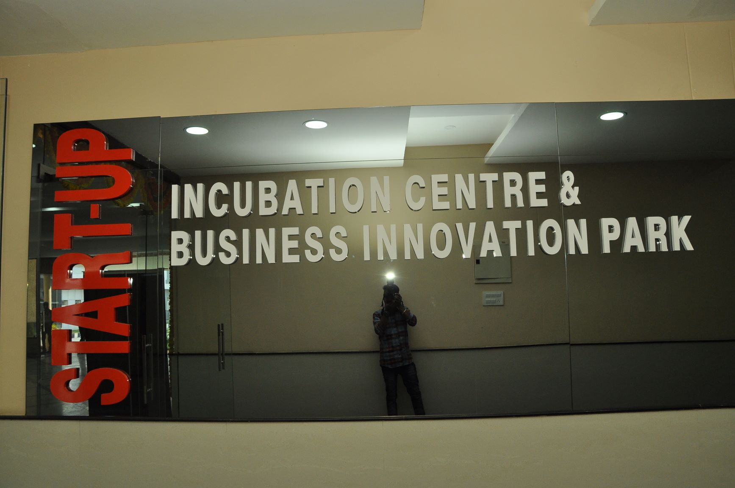
STSP – (Full Image Template)
Start – up and Business Identification
Electronic Reuse
SPORTSWAN – Sports World and Network
App for Blind People

Slide 14
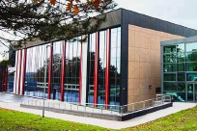
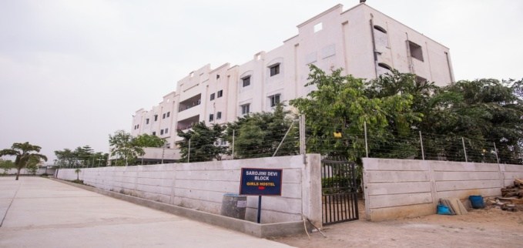
Infrastructure at a Glance (Images with text – vertical)
Four Academic Blocks
Innovation Centre
Career Development Centre
R & D Centre
Wi – Fi Campus, 300 Mbps connectivity
Hi – tech Laboratories
Central Library
Auditorium, Seminar Halls, Flipped Class Room and Computer Centre
Excellent sports facilities
Bank – ATM
Two Hostel Blocks

Slide 15
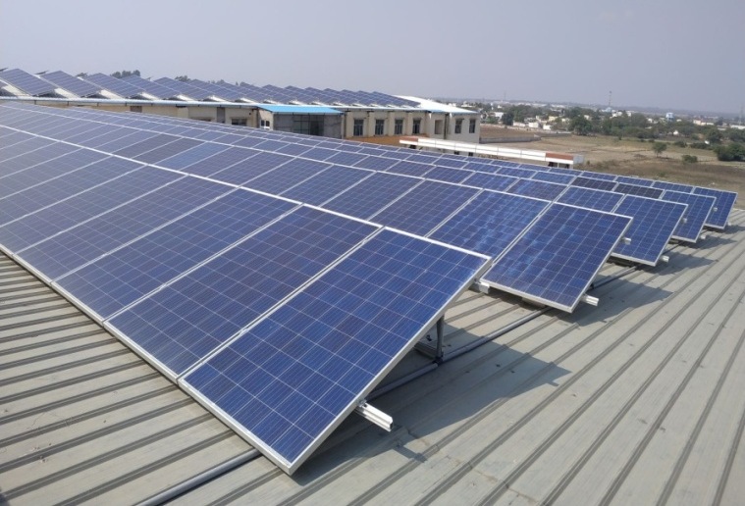
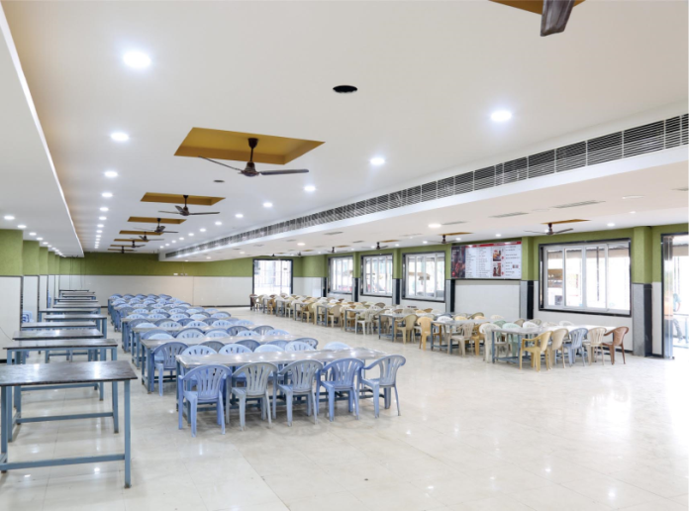
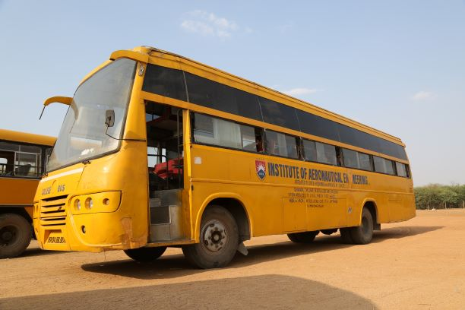
Campus Facilities (Images with text – horizontal)
Housekeeping
Power Backup (4Generator 180 KVA, 125 KVA (2 nos) and 62 KVA, 40 UPS (Varying from 6 KVA to 20 KVA))
Solar Power – 160 KW
Centralized RO Water Plant
Fleet of 32 vehicles for transportation of students and faculty
Canteen (Air – Conditioned)

Slide 16
Conclusion
The Institute is constantly striving for “Excellence”, the evidences of which are furnished in the presentation; and put forth before the NBA team for perusal and Evaluation.
Management supports and derives pride in all our success plans.

Slide 17
We are a…
Progressive, Forward-Looking, Positive Enthusiastic, Vibrant Community at IARE
We seek your advise and guidance to further Enhance the quality of all our services.

